Slide 1
An information-theoretical approach to internal models in a Partially Observable Markov Decision Process
By Lukas Prader
Supervisors: Alexander Vining, Hans J. Briegel Group: Quantum Information & Computation

Slide 2

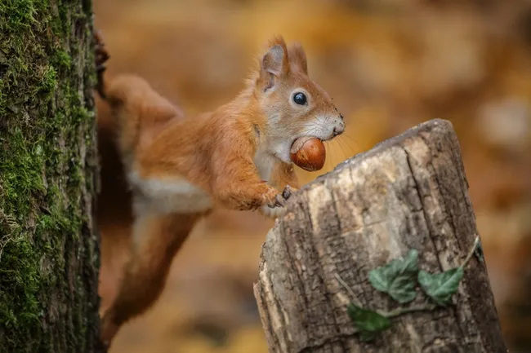
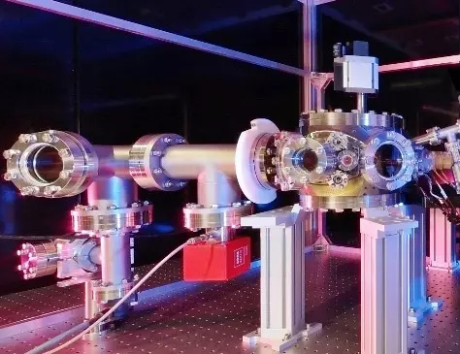
How can an agent learn about the structure of its environment?
https://www.westend61.de/en/photo/FO006476/brazil-mato-grosso-mato-grosso-do-sul-pantanal-giant-anteater-and-termite-hill
https://www.livescience.com/64104-how-do-squirrels-find-buried-nuts.html
https://www.uibk.ac.at/exphys/index.html.en

Slide 3
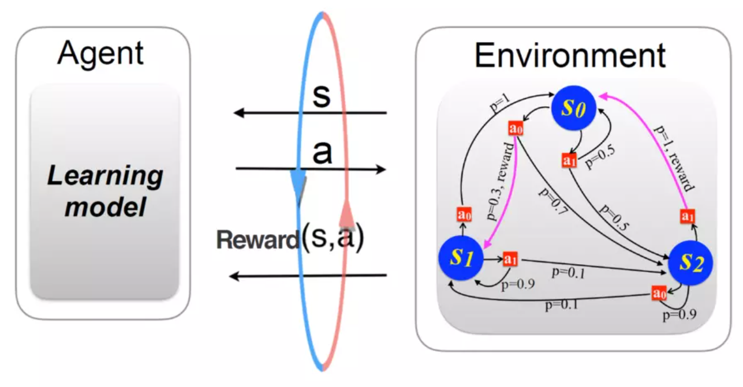
How can an agent learn about the structure of its environment?
https://www.uibk.ac.at/th-physik/qic-group/research/topics/ai-and-science/

Slide 4
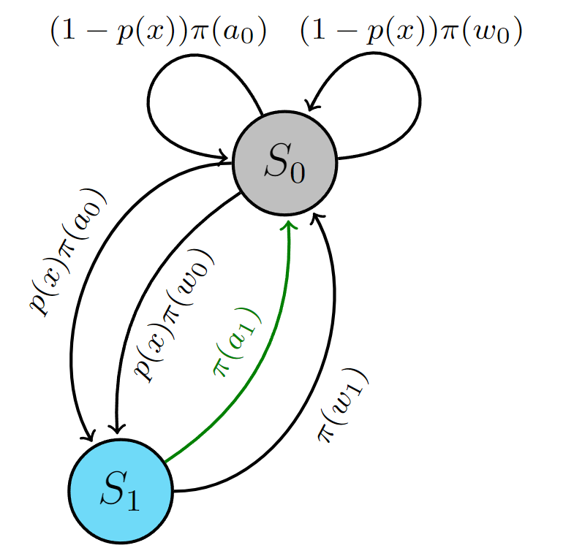
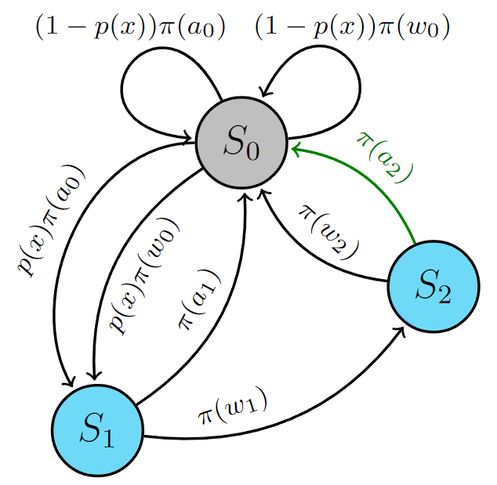
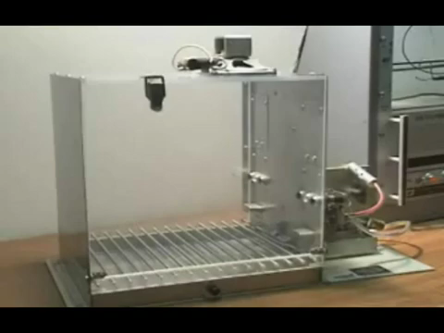
The Skinner Box as a Partially Observable Markov Decision Process
https://www.youtube.com/watch?v=lxImLwqY0Jc&t=1s

Slide 5
The Skinner Box as a Partially Observable Markov Decision Process
What observations are needed to understand this process?
While only observing the light, can an observer infer the existence of “hidden” states?

Slide 6
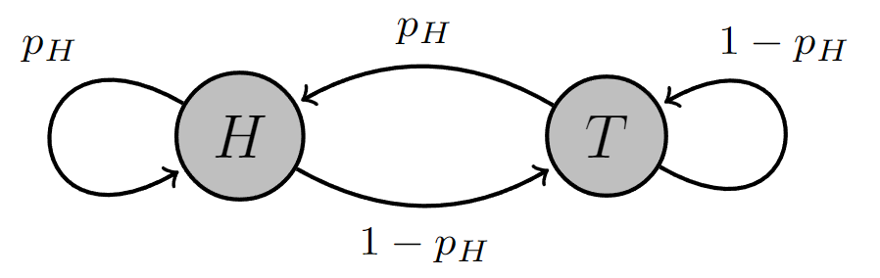
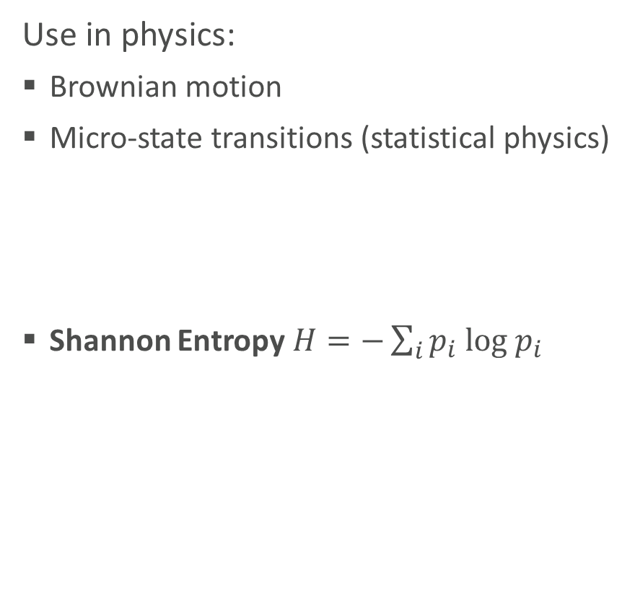
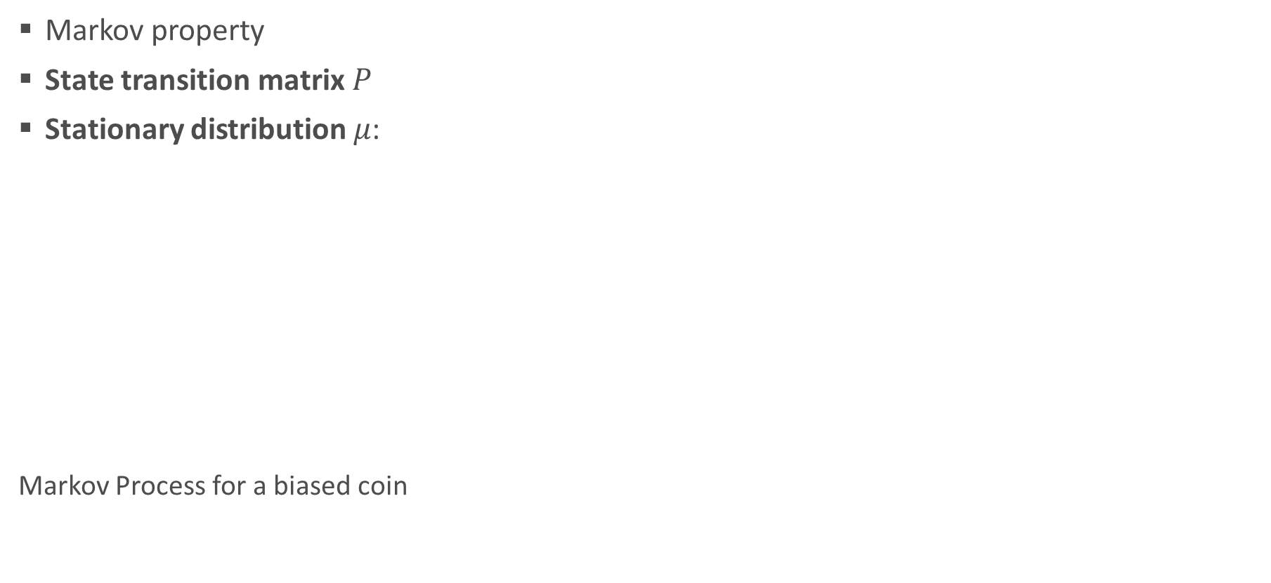
Markov Processes and Information Theory
Markov property
State transition matrix $P$
Stationary distribution $μ$:
Markov Process for a biased coin
Use in physics:
Brownian motion
Micro-state transitions (statistical physics)
Shannon Entropy $H=−\sum_{i}{p_{i} log{ p}_{i} }$
Cover & Thomas, Elements of Information Theory

Slide 7
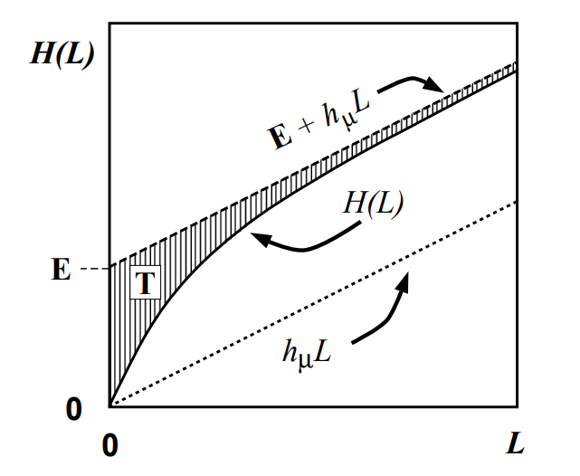
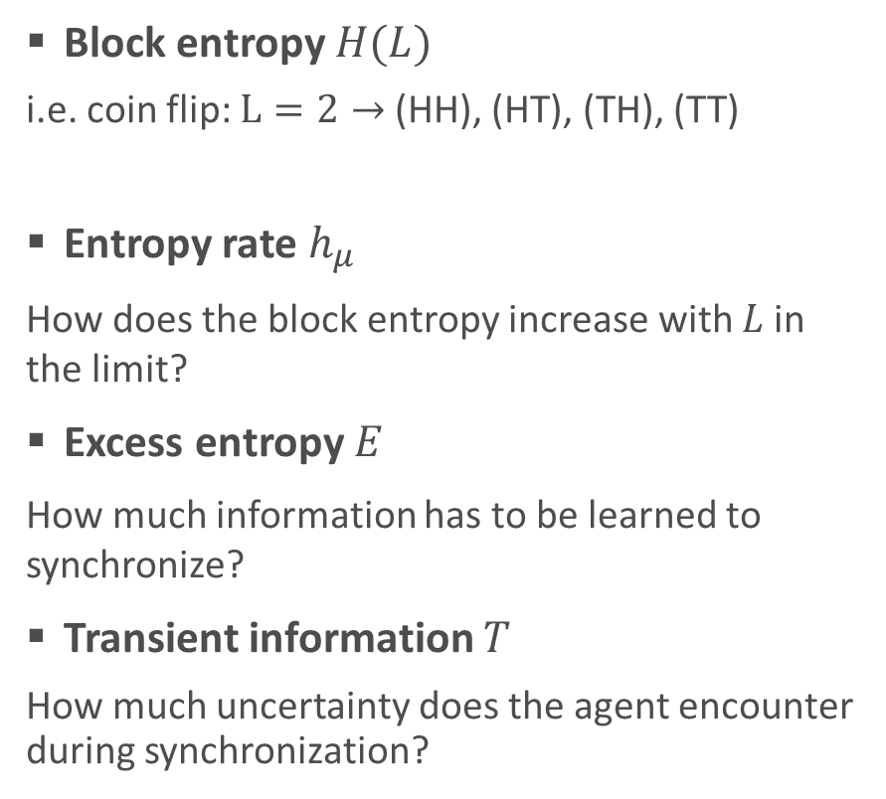
Information Theory and Synchronization
Block entropy $H(L)$
i.e. coin flip: $L=2→$ (HH), (HT), (TH), (TT)
Entropy rate $h_{μ}$
How does the block entropy increase with $L$in the limit?
Excess entropy $E$
How much information has to be learned to synchronize?
Transient information $T$
How much uncertainty does the agent encounter during synchronization?
Learning as “synchronization” to the environment
Crutchfield & Feldman, 2003

Slide 8
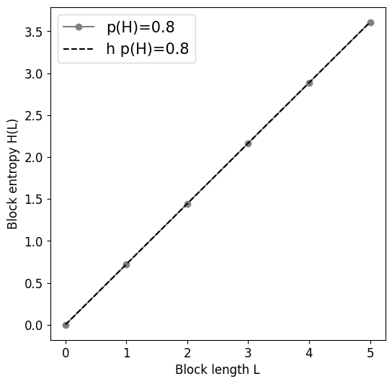
Information Theory and Synchronization for a biased coin
Crutchfield & Feldman, 2003

Slide 9
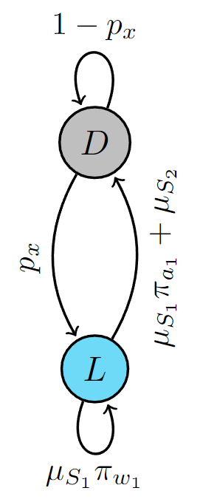
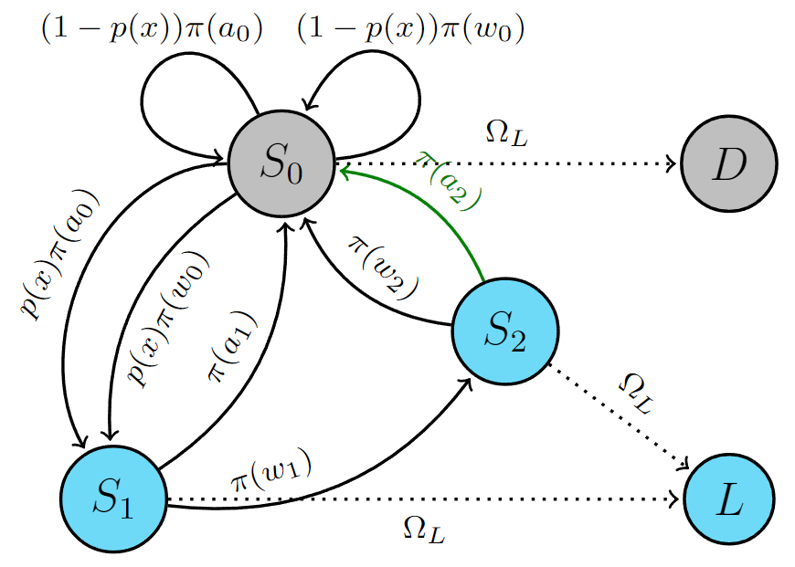
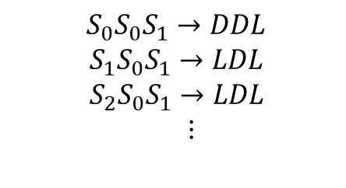
Reducing the delayed action MDP
Only parts of the process can be observed
The process is assumed to already be in stationarity
$$S_{0}S_{0}S_{1}→DDL$$
${ S}_{1}S_{0}S_{1}→LDL$
${ S}_{2}S_{0}S_{1}→LDL$
$⋮$
MP1
MDP
Ω(L)

Slide 10
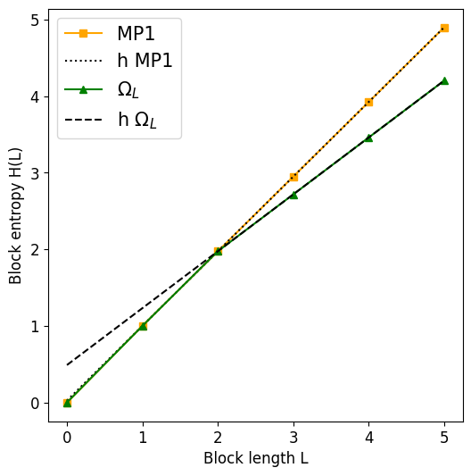
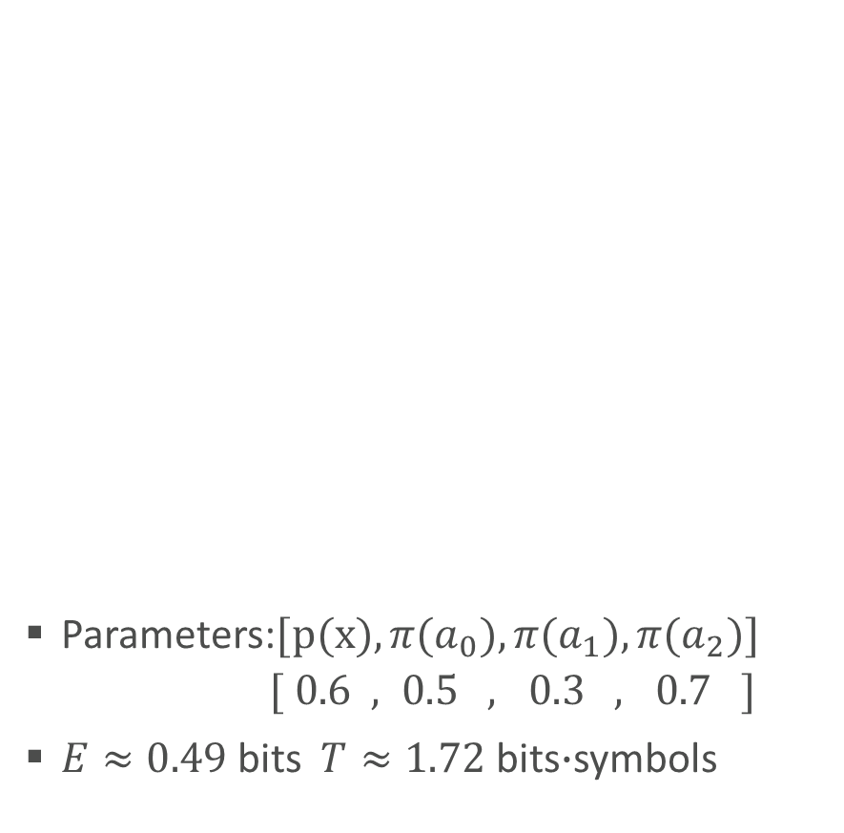
Analysing the block entropy behaviour
Parameters:$[p(x),π(a_{0}),π(a_{1}),π(a_{2})]$
$[ 0.6 , 0.5 , 0.3 , 0.7 ]$
$E≈0.49$ bits $T≈1.72$ bits$∙$symbols
MP1
MDP
Ω(L)

Slide 11
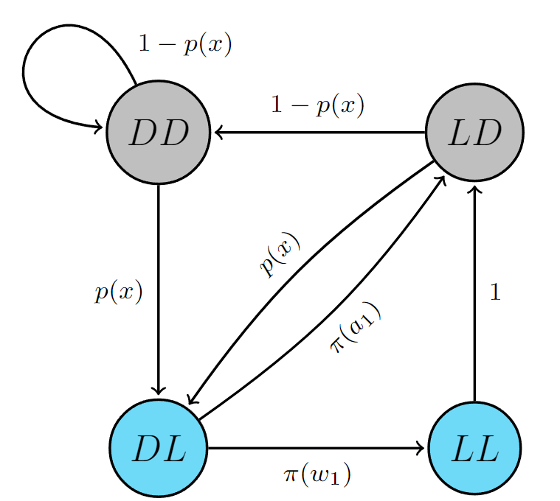
Analysing the block entropy behaviour
MP1
MDP
Ω(L)

Slide 12
Future directions
Look at observation of the action instead of light
Uncertainty bounds and minimum sample length
Use for internal model generation
How can an agent associate actions with observations in this model?

Slide 13
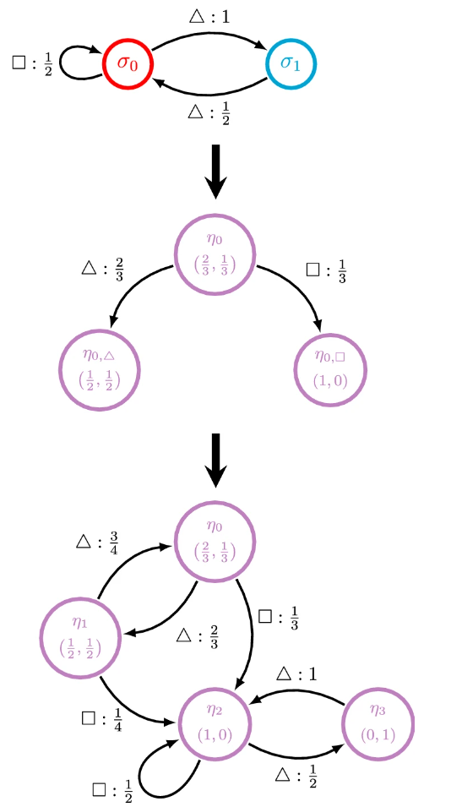
Use for internal model generation
Synchronization as an indicator for sufficient information
Creation of an “ϵ-machine” using the recurrent part of a mixed-state system
Using the information to optimize the policy, relating to reward
Jurgens & Crutchfield, 2021

Slide 14
Conclusion
The necessary length of observations for understanding the light behaviour of the delayed action task is L=2.
Information theoretical measures can be used to understand the process of internal model formation.

Slide 15
Literary sources
Cover & Thomas: Elements of Information Theory, 1999
Crutchfield & Feldman: Regularities Unseen, Randomness Observed: Levels of Entropy Convergence, 2003
Jurgens & Crutchfield: Shannon entropy rate of hidden Markov processes, 2021

